Slide 1
Roses & LimaÇons
Precalculus Honors – Section 6.5

Slide 2
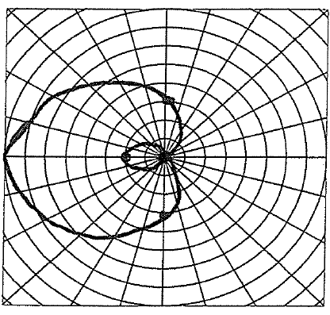
Q1. Write an equation to match the graph:

Slide 3
A1. Write an equation to match the graph:

Slide 4
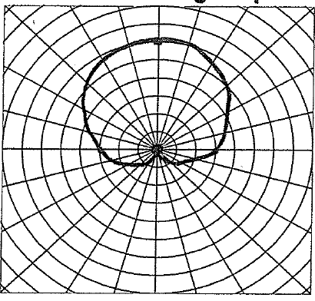
Q2. Write an equation to match the graph:

Slide 5
A2. Write an equation to match the graph:

Slide 6
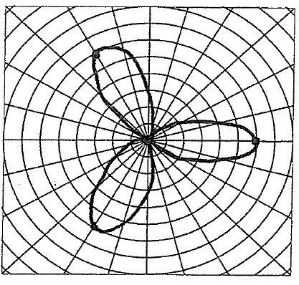
Q3. Write an equation to match the graph:

Slide 7
A3. Write an equation to match the graph:

Slide 8
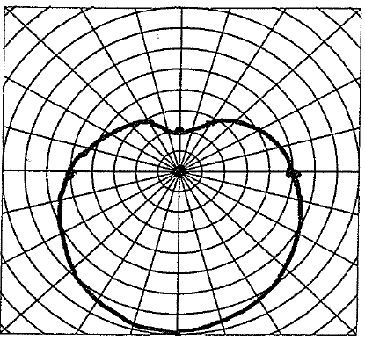
Q4. Write an equation to match the graph:

Slide 9
A4. Write an equation to match the graph:

Slide 10
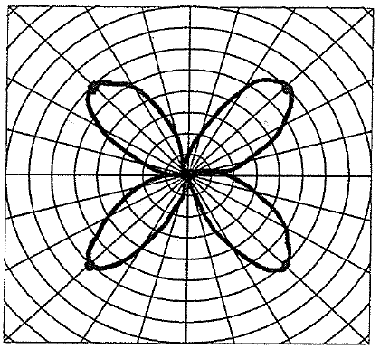
Q5. Write an equation to match the graph:

Slide 11
A5. Write an equation to match the graph:

Slide 12
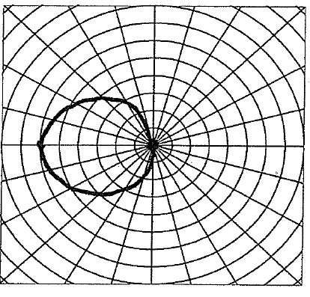
Q6. Write an equation to match the graph:

Slide 13
A6. Write an equation to match the graph:

Slide 14
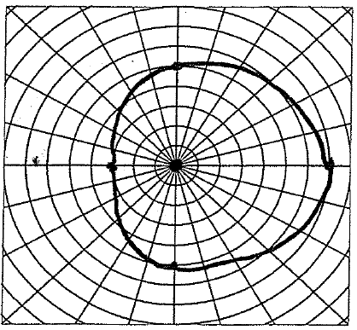
Q7. Write an equation to match the graph:

Slide 15
A7. Write an equation to match the graph:

Slide 16
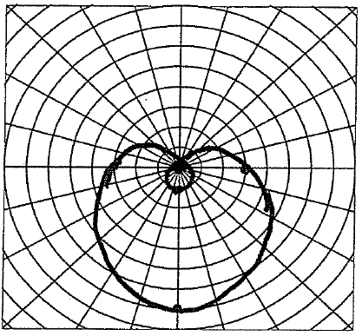
Q8. Write an equation to match the graph:

Slide 17
A8. Write an equation to match the graph:

Slide 18
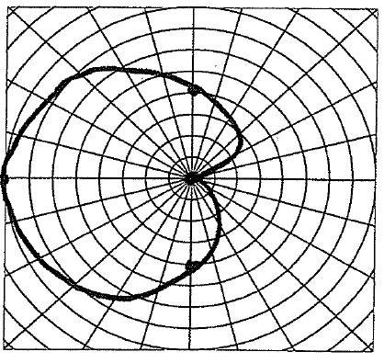
Q9. Write an equation to match the graph:

Slide 19
A9. Write an equation to match the graph:

Slide 20
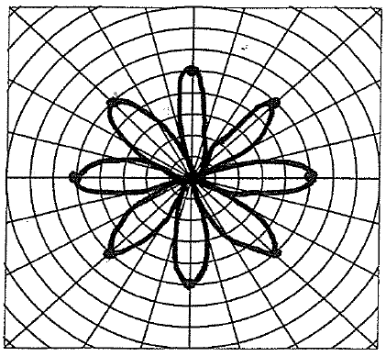
Q10. Write an equation to match the graph:

Slide 21
A10. Write an equation to match the graph:

Slide 22
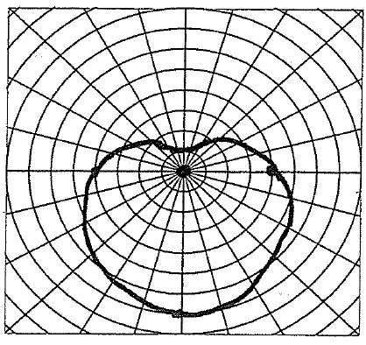
Q11. Write an equation to match the graph:

Slide 23
A11. Write an equation to match the graph:

Slide 24
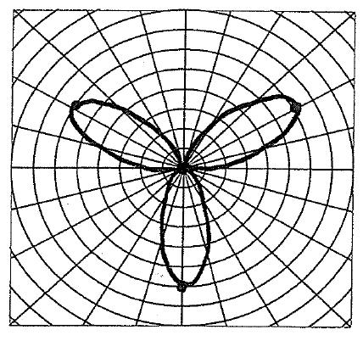
Q12. Write an equation to match the graph:

Slide 25
A12. Write an equation to match the graph:

Slide 26
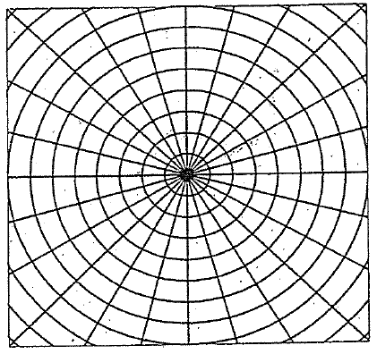
Q13. Sketch the function

Slide 27
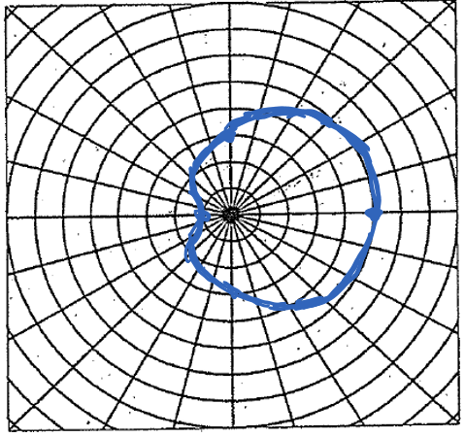
A13. Sketch the function

Slide 28
Q14. Sketch the function

Slide 29
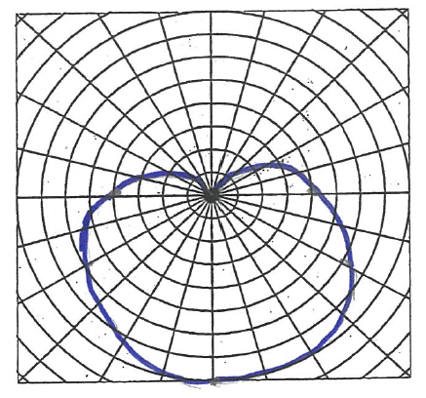
A14. Sketch the function

Slide 30
Q15. Sketch the function

Slide 31
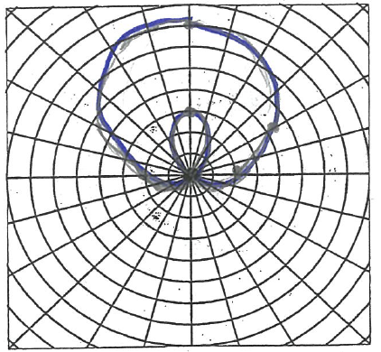
A15. Sketch the function

Slide 32
Q16. Sketch the function

Slide 33
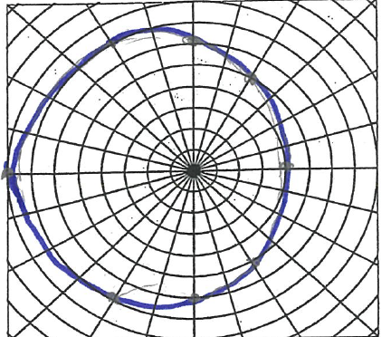
A16. Sketch the function

Slide 34
Q17. Sketch the function

Slide 35
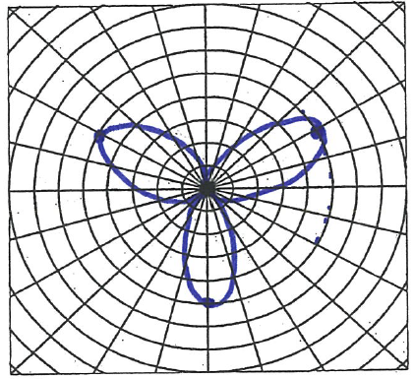
A17. Sketch the function

Slide 36
Q18. Sketch the function

Slide 37
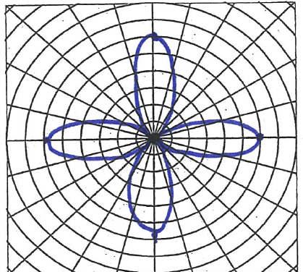
A18. Sketch the function

Slide 38
Q19. Sketch the function

Slide 39
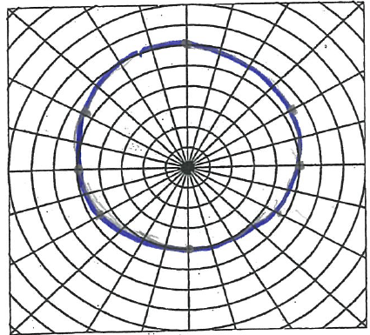
A19. Sketch the function

Slide 40
Q20. Sketch the function

Slide 41
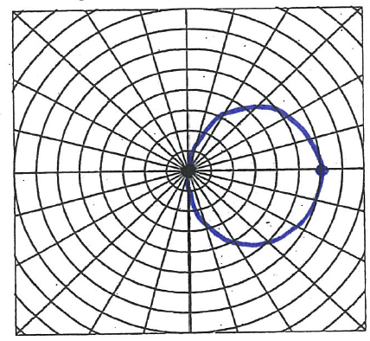
A20. Sketch the function

Slide 42
Q21. Sketch the function

Slide 43
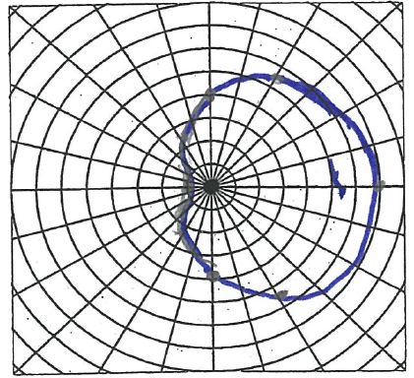
A21. Sketch the function

Slide 44
Q22. Sketch the function

Slide 45
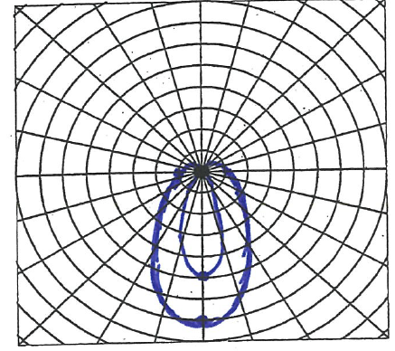
A22. Sketch the function

Slide 46
Q23. Sketch the function

Slide 47
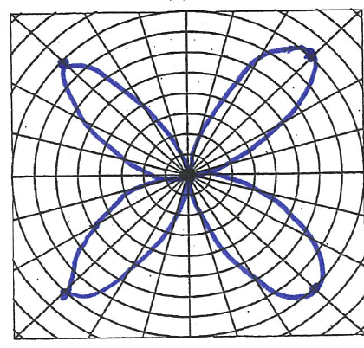
A23. Sketch the function

Slide 48
Q24. Sketch the function

Slide 49
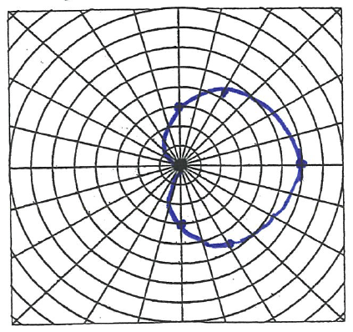
A24. Sketch the function

